Slide 1
AUTOMOBILES SALES ANALYSIS
NAME: AKSHITHA S REGISTER NO: 312209959 (D3D94D92CE42426878E454EBC944F4E7)
DEPARTMENT: COMMERCE COLLEGE: VALLIAMAL COLLEGE FOR WOMEN

Slide 2
AUTOMOBILES SALES ANALYSIS BY USING MICRO SOFT EXCEL

Slide 3
AGENDA
Problem statement
Project overview
Consumer preferences
Key factors
Result
Conclusion

Slide 4
PROBLEM STATEMENT
The automobiles industry is highly competitive and influenced by various factors such as economic conditions, consumer preferences, and technologies and advancements. Despite the potential for growth, many automobiles companies face challenges in predicting sales trends, identifying key drivers of sales, and making date-driven decisions to optimize inventory, pricing and marketing.

Slide 5
PROJECT OVERVIEW
our project aims to analyse the overall sales of cars in automobiles industry.
We seek accurately the sales ration of the automobiles industry.
The excel will expose the sales ration of the cars.

Slide 6
WHY PEOPLES LIKE AUTOMOBILES:
CONVINENCE AND INDEPENDENCE
COMFORT AND SAFETY
STATUS AND IDENTITY
TECHNOLOGICAL APPEAL
ECONOMIC NECESSITY
LEISURE AND ADVENTURE

Slide 7
ANALYZE SALES TRENDS
Time series analysis
Segment-wise analysis
Economic impact
Consumer landscape
Consumer behaviour trends
Competitive landscape

Slide 8
Economic impact
The economic impact on automobile sales is profound, as various economic factors directly influence consumer behavior, manufacturing costs, and overall market dynamics. Here’s a breakdown of how economic conditions affect automobile sales.

Slide 9
REASON FOR HIGH SALES
GLOBAL AVAILABILITY: the Toyota corolla is sold in over 150 countries, making it widely accessible.
Affordability: it is positioned as the reliable and affordable vehicle for the average consumer.

Slide 10
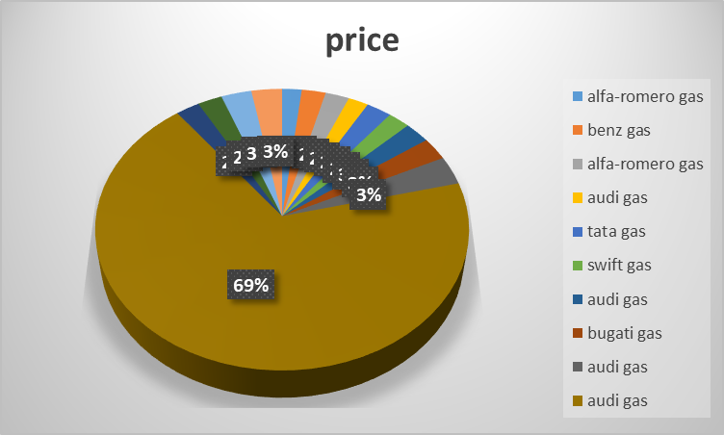
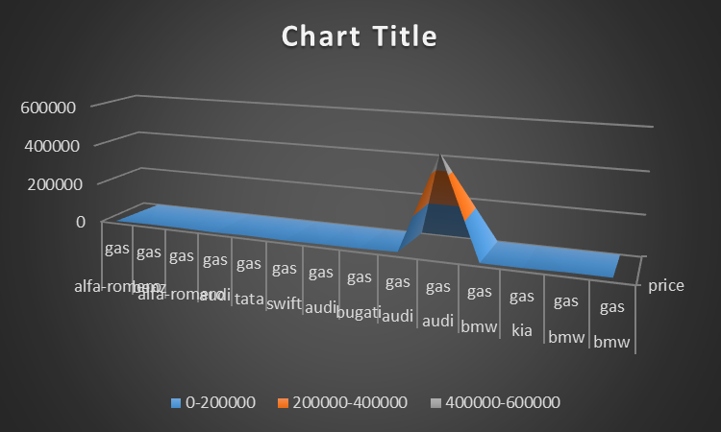
RESULT

Slide 11
CONCLUSION
By analysing these sales trend, companies can gain valuable insights into market dynamics, allowing them to make informed decisions on inventory management, market strategies, product development, and overall business planning.

Slide 12
THANK YOU!

